Slide 1
ANN Project
Traffic Volume Prediction
BY
Hitesh Thadhani and Prankur Garg
Video Presentation Link
https://www.youtube.com/watch?v=PWY5HILM1nI&t=785s

Slide 2
Contents
Problem statement
Relevant work
About the Dataset
Data Pre-processing
Approach
Experiments and Results
Conclusion
Future scope
References

Slide 3
Problem statement
With more than 1 billion cars on roads today, which is expected to double to around 2.5 billion by 2050, designing superefficient navigation and safer travel system is becoming a major challenge for transportation authorities.
Increase in number of vehicles has led to increase in pollution and travel time for the commuters.
To face this challenge:
Accurate traffic volume prediction is a must since it would provide guidance to the individuals to choose the best time to travel to avoid unnecessary delays due to roadblocks or take alternate routes.
Help officials to monitor the flow of traffic and make necessary arrangements to facilitate the proper traffic system in that area.

Slide 4
Relevant Work
Short-term traffic volume predictions have been carried out for decades since the 1980’s.
Traditional time series methods have been used to forecast the traffic volume including ARMA, ARIMA.
These methods are used to model univariate time series by capturing the linear relationships.
Deep Neural Networks have recently showed promising results by capturing complex nonlinear dependencies along with accounting for external factors like weather or events.
2 of the research papers talk about how the weather conditions influence the traffic volume and the weather information can improve the performance of the models for multivariate time series forecasting.

Slide 5
About the Dataset
The Metro Interstate Traffic Volume dataset is taken from UC Irvine Machine Learning Repository.
The dataset is about the traffic volume for MN DoT ATR station 301, roughly midway between Minneapolis and St Paul, MN.
This dataset consists of weather, holiday and temperature information along with concentration of traffic for that area for every hour from 2012 to 2018.
This dataset can be modeled as Univariate as well as Multivariate Time series problem for building deep learning models predicting future traffic.

Slide 6
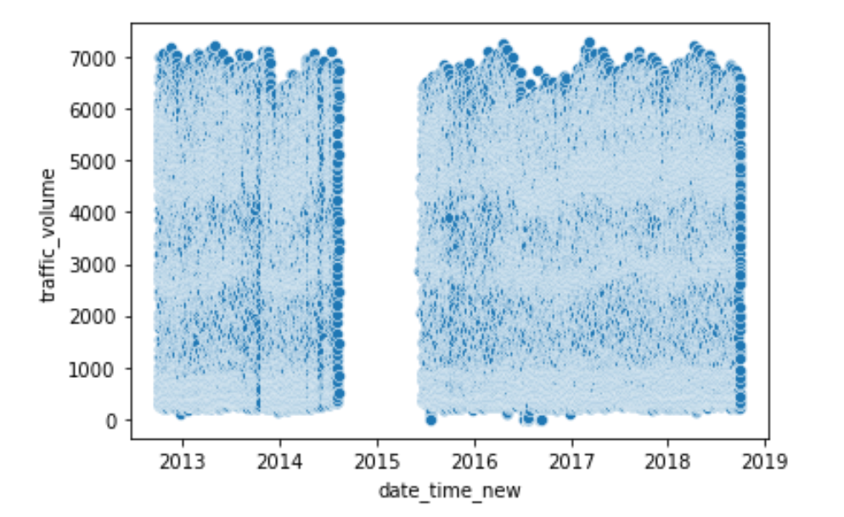
Data Pre-Processing
Dropped missing values from mid 2014 to mid 2015. (Total of 8 months)
Suppressed the outliers in some columns.
Label encoding for holiday column for initial use. Then it was converted to 0 and 1 using one hot encoding.
Entity embedding to encode weather desc and holiday column using numeric vectors of length 17 and 6 respectively.
Missing values were imputed using time interpolation technique for numerical variables and backfill for categorical weather variable.
Rectified an anomaly in holiday column to count the whole day as holiday instead of just the first hour.
Performed EDA for finding patterns for weekday and weekends for holiday and non holiday data.

Slide 7
Approach
Pre-processed clean data is used to build neural network models for future traffic flow forecasting.
We decide on which features to use for our experiment first as a part of feature selection process.
Once the data with features is finalized, we convert the supervised data to time-series data format with lag of periods defined for our models to predict traffic volume at time t using data from t-n to t-1 time periods.
We build the models with the required number of hidden layers, optimizer etc. to run on train data. Data is split into train, validation and test for evaluating the model performance.
Each model is run 5 times and average RMSE and standard deviation along with computational effort needed is calculated to compare different models and evaluate the model performance.

Slide 8
Experiments and Results
For all the deep learning models including feed forward network, different hyperparameters are tuned to build a efficient model.
Different optimizers including RMSprop, Adam, AdaMax were tried. Adam came out to be the winner among the 3.
Number of hidden layers and neurons in each hidden layer were varied and various experiments were conducted. Smaller network with 2 hidden layers worked the best.
Early Stopping was used to train the models to avoid overfitting and reduce computational effort to stop training if validation loss doesn’t improve for 10 iterations. 50 epochs was found out to be good enough value to build all the models.
Dropouts as a mechanism for regularization was used to avoid overfitting and reduce randomly selected neurons to 0 to reduce model complexity.

Slide 9
Feed Forward Neural Networks
Feed forward neural network models with various experiments such as no categorical variables, weather and holiday label encoded, binarize categorical variables, entity embeddings for weather data used, training on 1 year data to predict rest of future traffic volumes etc. are carried and the results obtained are shown below.
 | Mean MSE | Mean RMSE | Computational Effort (epoch*number of weights)
No Categorical features | 0.0676±1.21E−6 | 0.260±0.0011 | 40*409= 16,360
Holiday and Weather data label encoded | 0.067±4.9E−7 | 0.259±0.0007 | 38*433=16,454
Binary Encoded Categorical Variables | 0.0686±4.0E−6 | 0.262±0.0020 | 38*433=16,454
Entity Embedding for weather feature | 0.0655±1.0E−6 | 0.256±0.0010 | 34*613=20,842
1 year data for training and rest for test | 0.0681±1.6E−7 | 0.261±0.0004 | 25*433=10,825
Predicting Holiday data using Non-holiday data trained model | 0.0676±1.44E−6 | 0.260±0.0012 | 35*433=15,155

Slide 10
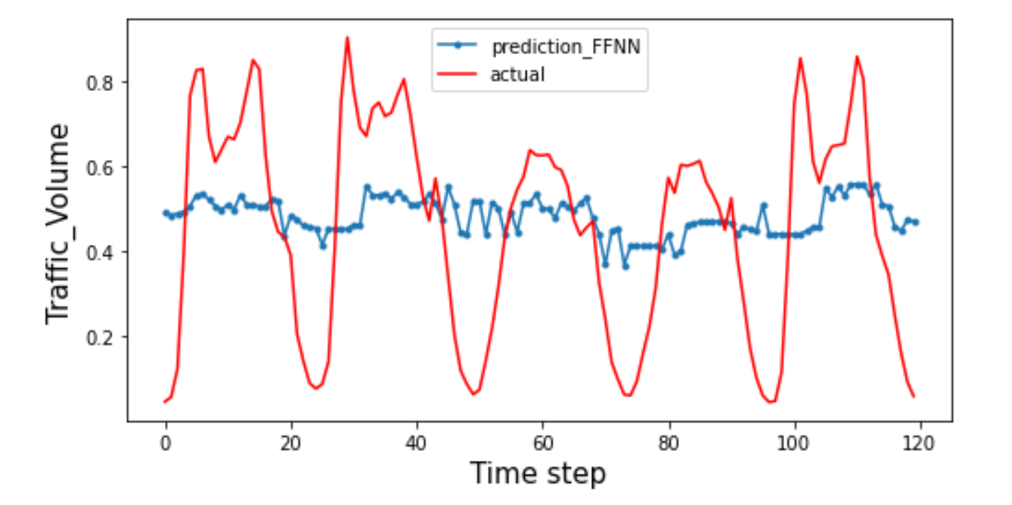
Conclusion for Feed forward networks
Best results considering the average and standard RMSE and prediction plot came out to be for experiment using Entity Embedding vector of size 17 for weather description.
Holiday and Weather data improve the model’s prediction capability making them important features.
Binarized holiday and weather data degrades the model’s performance slightly suggesting it is not a good idea to binarize them.
Holiday data prediction using non-holiday data trained model doesn’t produce convincing results.
Feed forward neural networks are not able to capture the time series effects of the data. The magnitude of predictions as well as the forecast trend is not captured by feed forward networks

Slide 11
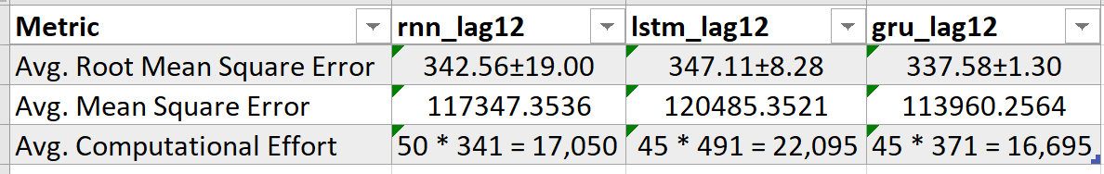
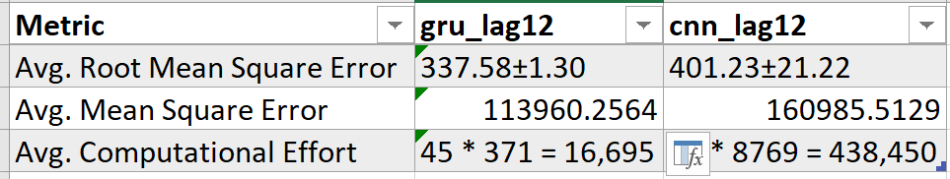
Univariate Time Series Forecasting
Univariate time series forecasting was conducted using 2 major variations with lag of 1 period and a lag of 12 periods to predict the future traffic volume.
Models which were run using the 12 period lag gave the best results after 5 iterations by comparing the average and standard deviation of RMSE and computational effort.
This average and standard deviation of RMSE along with computational effort was used to compare RNN, LSTM and GRU models.
CNN model was tried for predicting the traffic volume at time t using the previous 12 traffic volumes to compare it other Recurrent Neural Network (RNN) models.

Slide 12
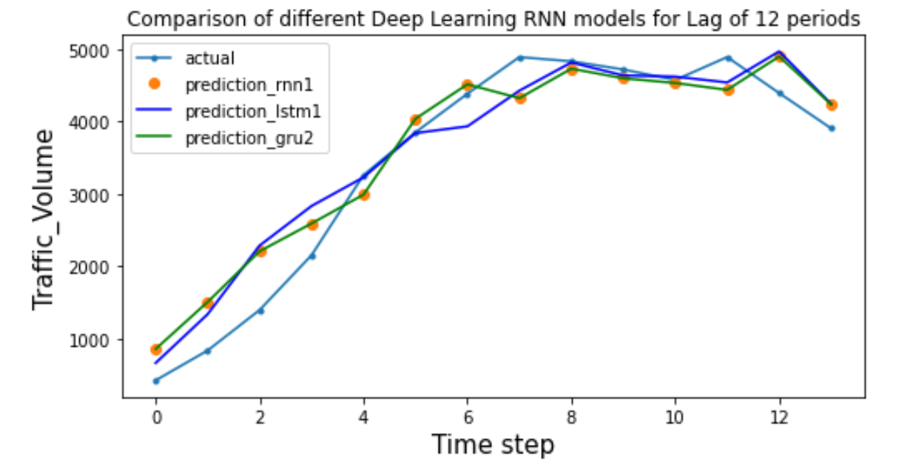
Conclusion for Univariate Time Series Forecasting
Univariate models which were fed 12 historic periods data outperformed the models where only previous traffic volume was fed.
Average RMSE was reduced to half for models with 12 lag periods as compared to models with 1 lag period.
GRU performed the best among all the 3 models when comparing the average RMSE and standard deviation which was drastically reduced to around 2 from 19 in RNN.
Computationally GRU was efficient given it has only 2 gates and executes faster than LSTM.
CNN models did not perform well considering the huge amount of computational effort needed by them 40 times more than GRU to achieve average RMSE worse than RNN and a very high fluctuating standard deviation.
GRU is almost the closest possible to the actual traffic volume as seen in the graph

Slide 13
Multivariate Time Series Forecasting
Conducted various experiments with different models (LSTM, GRU, RNN) using various combinations of hyper parameters on the whole dataset.
Ran 4 different ones for each of them. One was predicting using 1 year of data for training, one with basic parameters, one with varying hidden layers and lastly with data shifted by a period of 12 hours.
Used Avg. RMSE to compare the models. Lastly we used a predicting plot to compare and get the best model that is suitable for forecasting.
We found that for every model, the model with lag = 12 gave the best results.
We ran it 5 times to get the avg. and standard deviation. We named it as EXP1
Repeated the whole process from above and ran a model with dropped columns (holiday and weather desc.) to check if there is a difference in the final result. We names it as EXP 2

Slide 14
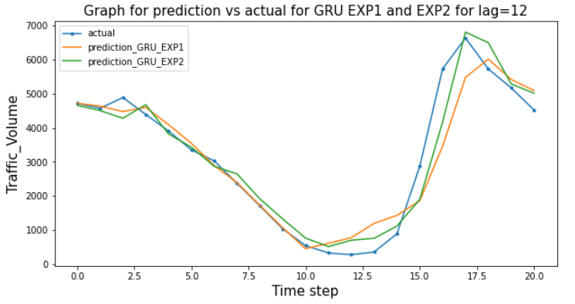
Conclusion for Multivariate Time Series Forecasting
After Conducting all the experiments, it was found that the best overall model was GRU for all the experiments.
GRU had the least MSE score among all.
GRU with lag = 12 had half the MSE as compared to GRU with lag = 1.
GRU on whole dataset ran much better than the other. It had mean = 485.95 and Stdev = 30.70. Although,it required more computational effort.
It can be inferred that holiday and weather are important features for traffic volume prediction
GRU Model for lag = 12 | Parameters | Avg. epochs | Computation effort
GRU EXP1 | 630 | 40 | 25,200
GRU EXP2 | 540 | 37 | 19,980

Slide 15
Future Scope
Incorporate spatial domain with the currently used temporal domain to make a combined Spatial Temporal Traffic Volume Prediction which involves traffic images analyzed using CNN’s along with RNN models for temporal features to enhance the prediction capability of the deep neural networks (DNN).
Encoders and Decoders for time series data modeling using RNN models can be used in future. Encoders and decoders are very useful when predicting the multistep time series data with the output not limited to just 1 at every interval but consists of multi sequence prediction at every interval.

Slide 16
References
https://archive.ics.uci.edu/ml/datasets/Metro+Interstate+Traffic+Volume
Li, Wan, Wang, Jingxing, Fan, Rong, Zhang, Yiran, Guo, Qiangqiang, Siddique, Choudhury, and Ban, Xuegang. Short-term traffic state prediction from latent structures: Accuracy vs. efficiency. United States: N. p., 2019. Web. doi:10.1016/j.trc.2019.12.007.
arXiv:1803.01254 [cs.LG]
Yuankai Wu, Huachun Tan, Lingqiao Qin, Bin Ran, Zhuxi Jiang. A hybrid deep learning based traffic flow prediction method and its understanding, Transportation Research Part C: Emerging Technologies
A. Koesdwiady, R. Soua and F. Karray, " Improving Traffic Flow Prediction With Weather Information in Connected Cars: A Deep Learning Approach," in IEEE Transactions on Vehicular Technology, vol. 65, no. 12, pp. 9508-9517, Dec. 2016, doi: 10.1109/TVT.2016.2585575.

Slide 17
References
D. Zhang and M. R. Kabuka, " Combining weather condition data to predict traffic flow: A GRU based deep learning approach", Proc. Int. Conf. Pervasive Intell. Comput. Int. Conf. Big Data Intell. Comput. Cyber Sci. Technol. Congre., pp. 1216-1219, 2018.
https://jingqingz.github.io/files/projects/2017-09-EnglandHighway/report.pdf
https://en.wikipedia.org/wiki/Long_short-term_memory
https://en.wikipedia.org/wiki/Gated_recurrent_unit
https://towardsdatascience.com/encoder-decoder-model-for-multistep-time-series-forecasting-using-pytorch-5d54c6af6e60
Zeinab S Jalali, Chilukuri K. Mohan. LSTM Based Time-Series Link Prediction

Slide 18
THANK YOU

